Slide 1


DETECTION OF
PHISHING WEBSITES
USING DEEP LEARNING
PRESENTED BY: GAURI PRADEEP
GUIDED BY : DR FOUSIA M SHAMSUDEEN

Slide 2

INTRODUCTION
Phishing is a type of cyberattack where attackers impersonate legitimate entities to deceive individuals into revealing sensitive information
Purpose of Phishing:
Stealing personal or financial information.
Gaining unauthorized access to systems and networks.

Slide 3
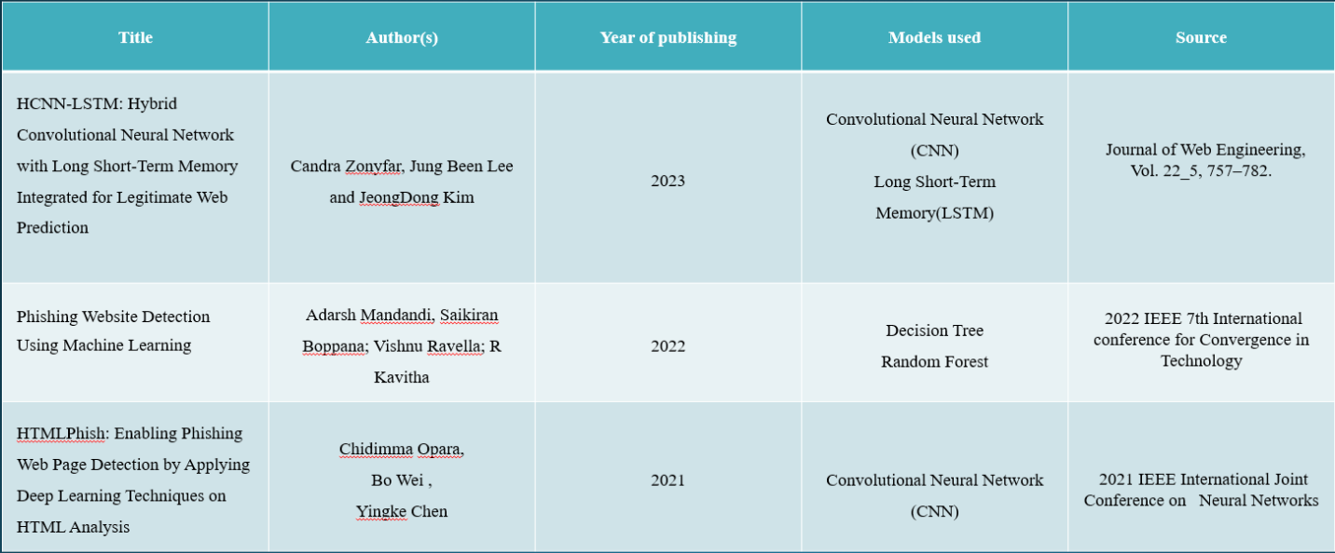
LITERATURE REVIEW

Slide 4
GAP IDENTIFIED
Traditional machine learning approaches often struggle with accuracy and real-time detection
Lack of Combined Feature Extraction when using a single deep learning model
PROPOSED SOLUTION TO THE IDENTIFIED GAP
A meta-learning based CNN-BiLSTM hybrid model that enables combined
feature extraction and improved adaptability

Slide 5

PROBLEM STATEMENT
Develop a hybrid CNN-BiLSTM model based on Meta-learning approach to allow combined feature extraction.

Slide 6
OBJECTIVES
To build a hybrid deep learning model.
To improve adaptability, introduce Meta-learning approach.
To classify the URL as phishing or legitimate.
To develop a web app to provide real-time phishing url detection.

Slide 7
METHODOLOGY
Data Collection and preprocessing
CNN-BiLSTM Model Development
Meta-learning approach using Reptile algorithm
Hyperparameter tuning to optimize model performance
Saving best model
Model evaluation

Slide 8
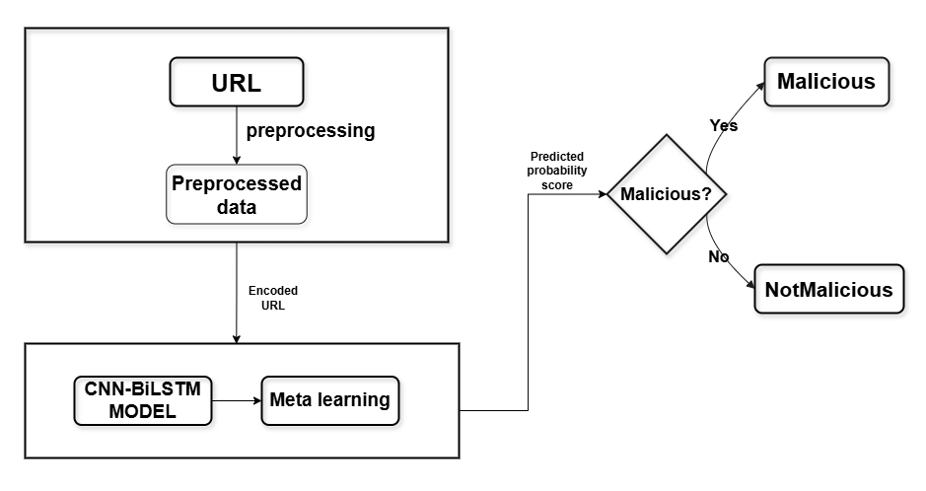
BLOCK DIAGRAM

Slide 9
RESULTS
Accuracy | 97.50
Precision | 97.80
Recall | 97.17
F1-score | 97.49

Slide 10
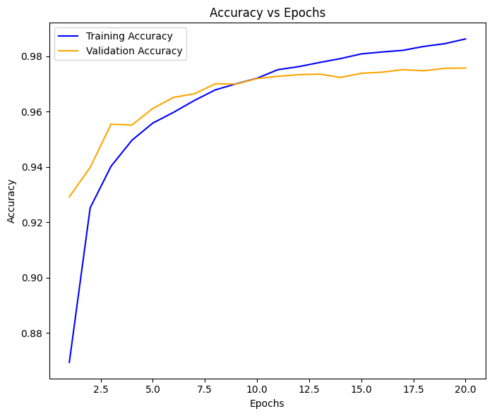
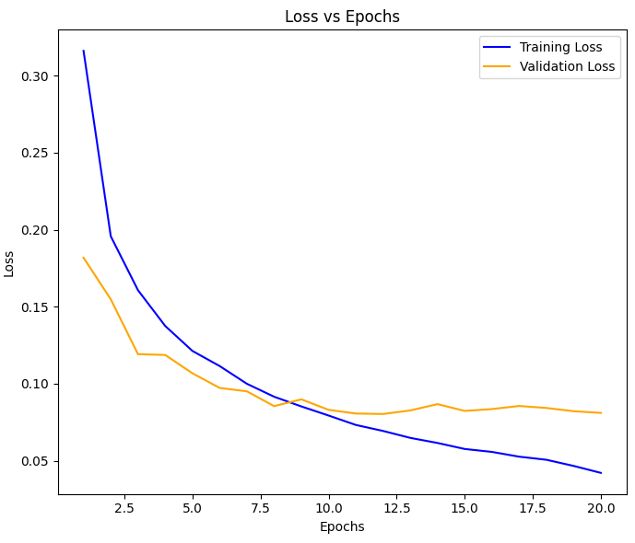
MODEL PERFORMANCE

Slide 11
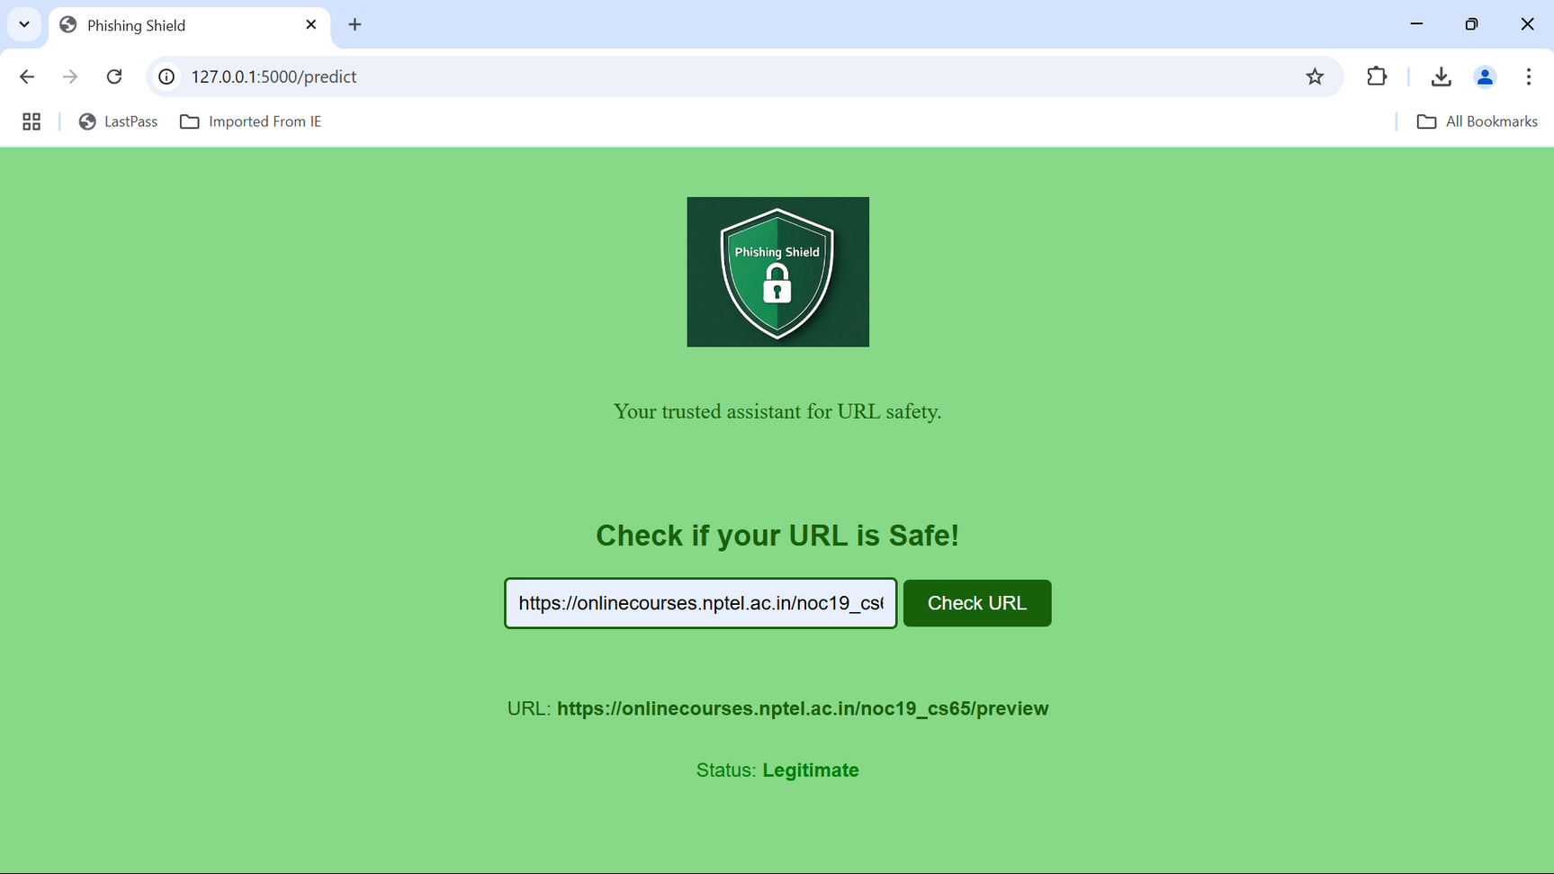
WEB APP INTERFACE

Slide 12


Slide 13
FUTURE ENHANCEMENTS
Integration with Browser Extensions
Phishing Type Classification
Use advanced Meta-Learning Techniques
Regional and Language-Specific Adaptation

Slide 14
THANK
YOU

